Slide 1
Sequencing similarity search and functional prediction
Vitor Pavinato
correapavinato.1@osu.edu

Slide 2
Plan for today
Sequence alignment
Pieces we need to put together to understand how it is done (how it works);
Office hours - introduction standalone Blast (in the afternoon and tomorrow during the lab);
Answer some questions raised during the lab (14/Jan/2022);
Biological significance of using different values for a nucleotide scoring matrix;
Sequence homology (Caenorhabditis elegans superoxide dismutase);
Is there a magic cutoff to decide if an alignment is significant?

Slide 3
Sequence alignment
Why do we align sequences?

Slide 4
Sequence alignment
Why do we align sequences?
Genome assembly
Find homologous
Find functional domains
Find Target for gene silencing

Slide 5
Motivation
You are conducting a differential gene expression analysis and, for example, you found an isoform (more about this next class) of a mRNA with unknown function associated with one of your treatments.
Then you look for the drosophila db to find the function of this gene
What is the rationality behind it?

Slide 6
“Nature is a tinkerer and not an inventor” (Jacob 1977)
“New sequences are adapted from pre-existing sequences rather than invented de novo. This is very fortunate for computational sequence analysis. We can often recognize a significant sequence similarity between a new sequence and a sequence about which something is already known;”
“When we do this, we transfer the information about structure and/or function to the new sequence. We say that the two related sequences are homologous and we transfer information by homology”
Durbin et al.1998

Slide 7
What is homology?
“Two regions of DNA that evolved from the same sequence (through processes of duplication of genomic regions and separation of two species) are homologous, or homologs of one another.
The Biostar Handbook: 2nd Edition.

Slide 8
Paralogous sequences or paralogs were separated by duplication of a genomic region within the same genome.”
Regions in the genomes of two species that are descended from the same area in a common ancestor’s genome are orthologs. These regions are said to be orthologous.

Slide 9
The concept of sequence alignment is crucial
Before the similarity between two sequence can be evaluated, we begin by founding a plausible alignment between them

Slide 10
Almost all alignment methods will eventually find the best alignment between two sequences under a score scheme
It then a matter of deciding whether the alignment had occur because the sequences were related or just by chance

Slide 11
Pieces we need
Score matrix
Type of alignment
An algorithm
Significance

Slide 12
Scoring matrix
Simplest nucleotide matrix
$$S_{ii}=1$$
 | A | T | C | G
A | 1 | -1 | -1 | -1
T | -1 | 1 | -1 | -1
C | -1 | -1 | 1 | -1
G | -1 | -1 | -1 | 1
$$S_{ij}=-1$$

Slide 13
Transition/Transversion ratio
Purines
Pyrimidines
A <-> G
C <-> T
Purines and Pyrimidines are structurally more similar to each other.
Non-coding sequences Ts/Tv = 2 to 1 (3 to 1)
C-> T and G-> A occurs more frequently.
the G-T mutation is the single most common mutation in human DNA. It occurs about once in every 10,000 to 100,000 base pairs
https://rosalind.info/glossary/transitiontransversion-ratio/

Slide 14
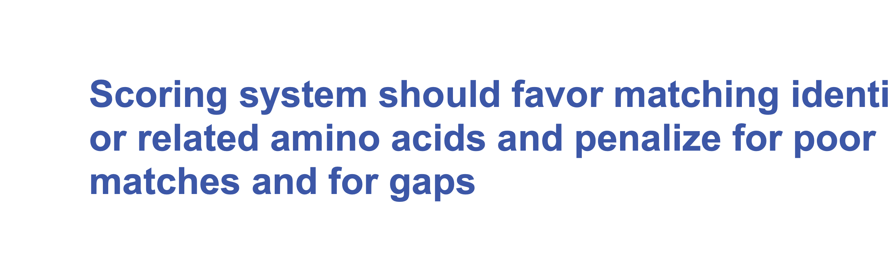

Slide 15
Type of alignments
Global alignment
Local alignment
Semi-global alignment (not covered in this class)
Multiple alignment (outside the scope of this course)
Short-read alignment (next week on RNAseq class)

Slide 16
Global alignment
When performing global alignments, the bases of both sequences are arranged next to one another over their entire length and all . Each base of the first sequence is matched to another base or a “gap” of the second sequence. We use global alignments when we are looking for an arrangement that maximizes the similarities over the entire length of both sequences:
Excerpt From: “The Biostar Handbook: 2nd Edition.”

Slide 17
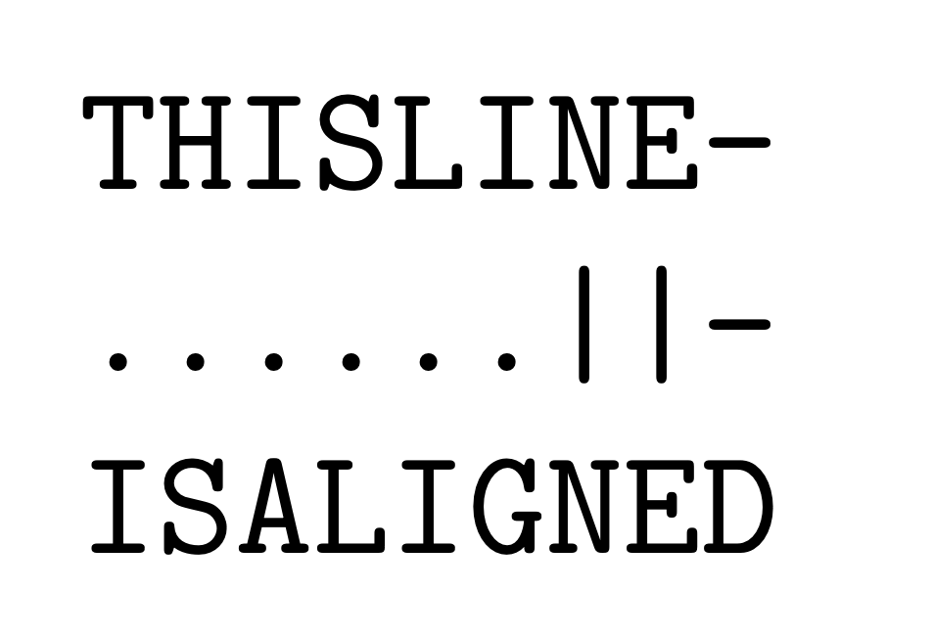
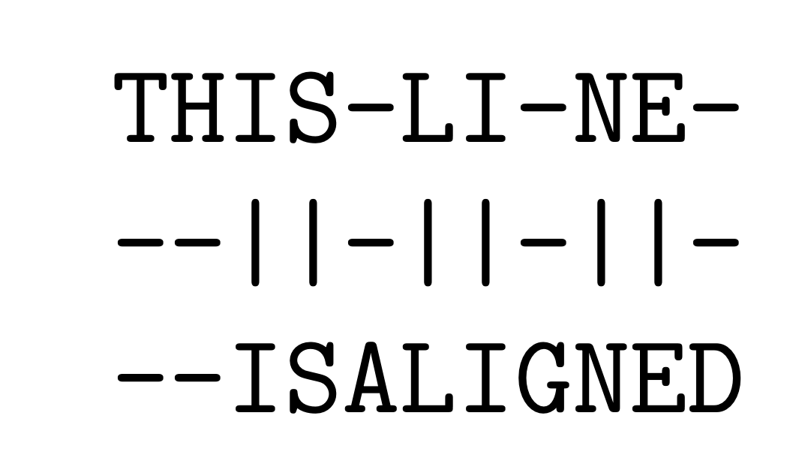
Global alignment
When performing global alignments, the bases of both sequences are arranged next to one another over their entire length and all . Each base of the first sequence is matched to another base or a “gap” of the second sequence. We use global alignments when we are looking for an arrangement that maximizes the similarities over the entire length of both sequences:
Excerpt From: “The Biostar Handbook: 2nd Edition.”

Slide 18
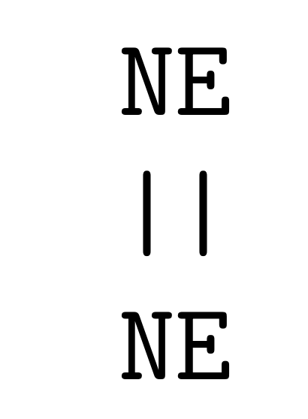
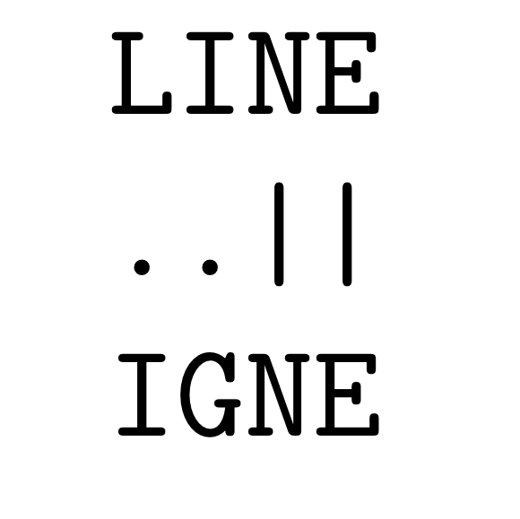
Local alignment
Local alignments are used when we need to find the region of maximal similarity between two sequences. When performing local alignments, the al- gorithms look for the highest scoring (partial) interval between the two sequences :
Basic Local Alignment Search Tool (BLAST)
Excerpt From: “The Biostar Handbook: 2nd Edition.”

Slide 19
Scope
Ungapped
Gapped
Linear
Affine

Slide 20
Simplest algorithm: ungapped local alignment
$$S_{ii}=1$$
 | C | C | A | A | G | G | T | C | A | G | T
A | X
C |  | *
C |  |  | X
G |  |  |  | X
G |  |  |  |  | *
G |  |  |  |  |  | *
T |  |  |  |  |  |  | *
T |  |  |  |  |  |  |  | X
T |  |  |  |  |  |  |  |  | X
T |  |  |  |  |  |  |  |  |  | X
$$S_{ij}=-1$$
How do you “walk" through the rows and columns?

Slide 21
Dynamic Programming: Recursion
$$F(i,j)=max\{\begin{aligned}0, \\ F(i-1,j-1)+s(x_{i},y_{j}), \\ F(i-1,j)-d, \\ F(i,j-1)-d.\end{aligned}$$

Slide 22
Dynamic Programming: Recursion

Slide 23
Determine significant
Identify the high scoring segments whose score S exceeds a cutoff x using a local alignment algorithm
$$P(S>x)=1-exp[-KMNe^{-λx}]$$
M and N are the length of the sequence and the database
K and $λ$ are positive parameters that depend on the scoring matrix and the composition of sequences being compared

Slide 24
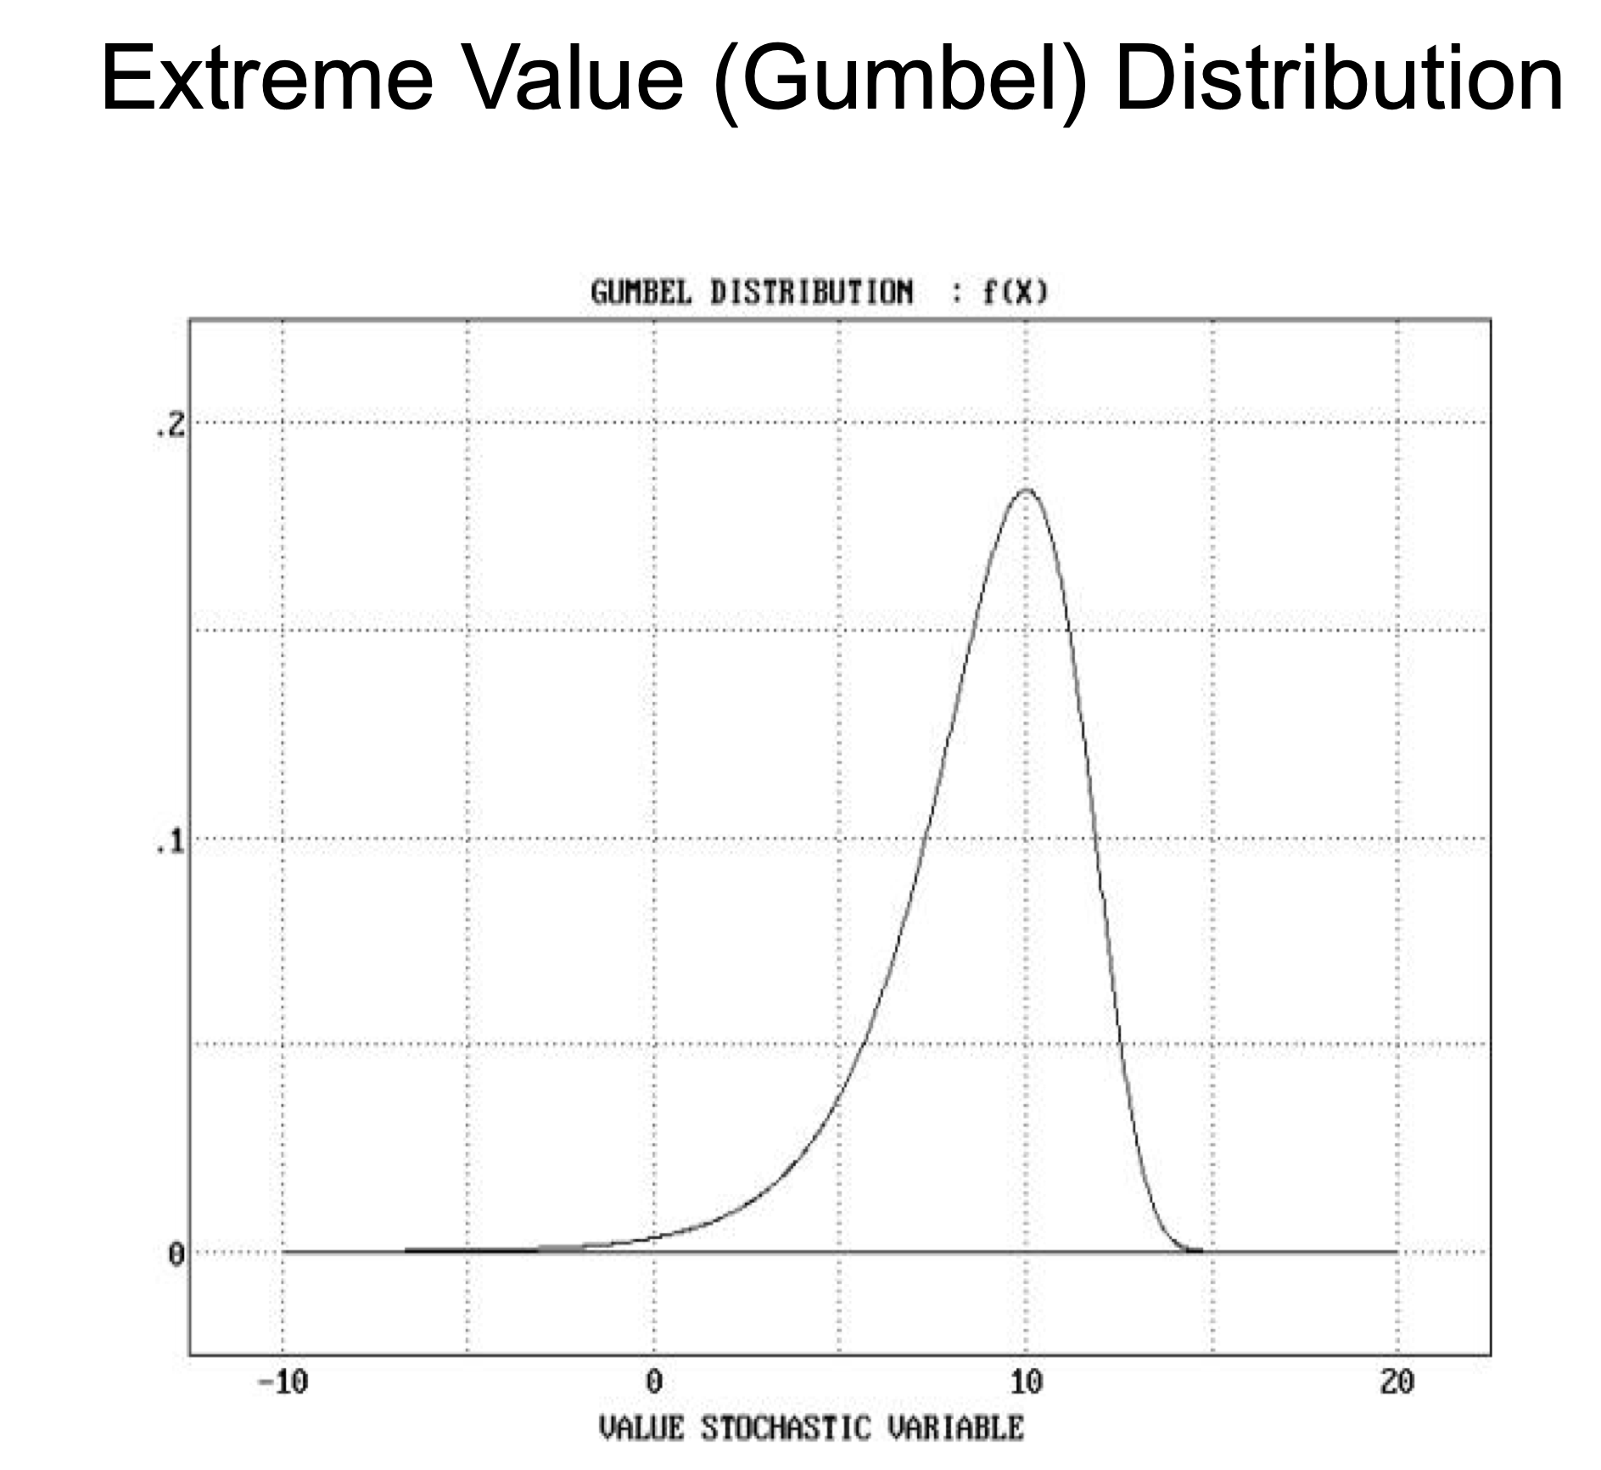
In order to find the segment with highest score, the expected value should be negative (reason we have a score matrix with negative values), but some positive are allowed.

Slide 25
How the subject size N affects P(S>x)?
K = 10
M = 100
N = 1,000
lambda = 2
$$P(S>10)=0.002059031$$
K = 10
M = 100
N = 1,000,000
lambda = 2
$$P(S>10)=0.872693$$

Slide 26
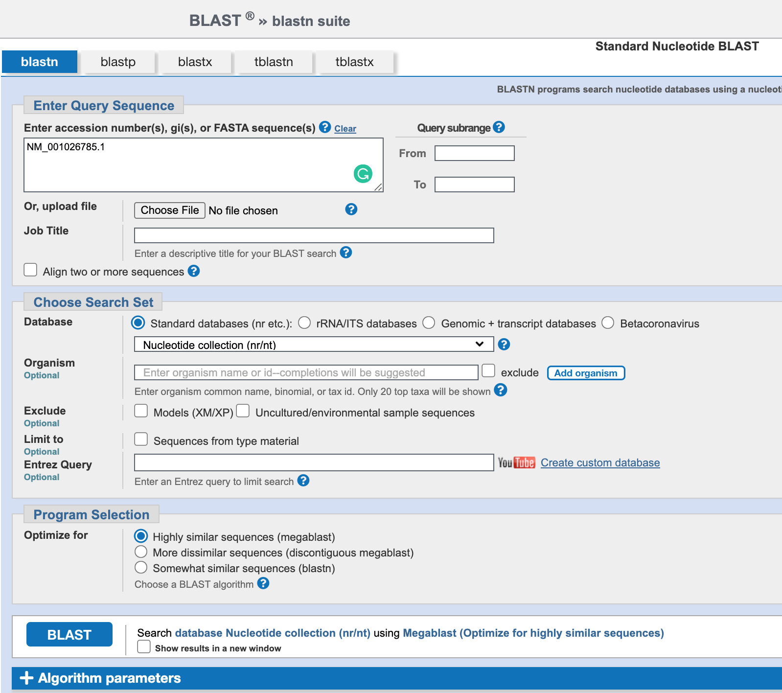
Database size

Slide 27
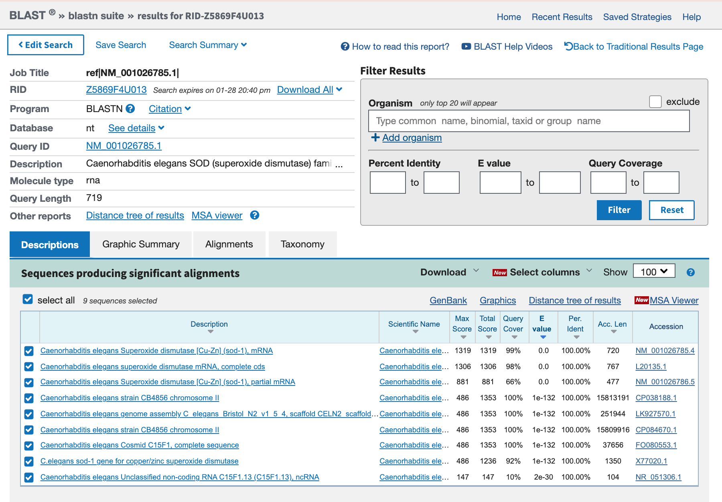

Slide 28
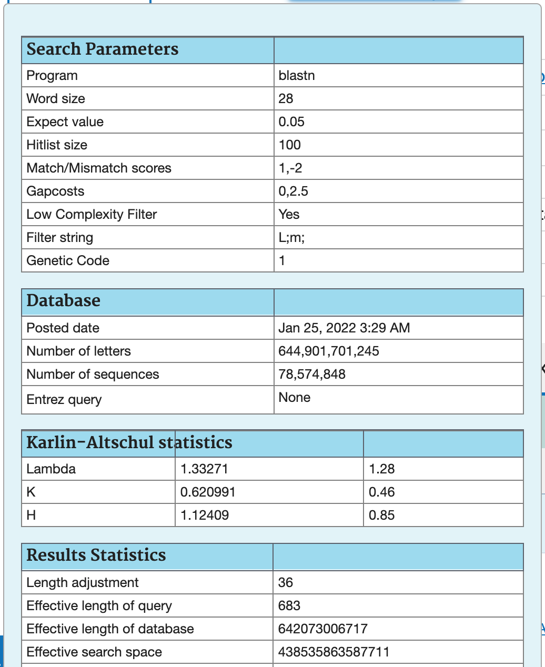

Slide 29
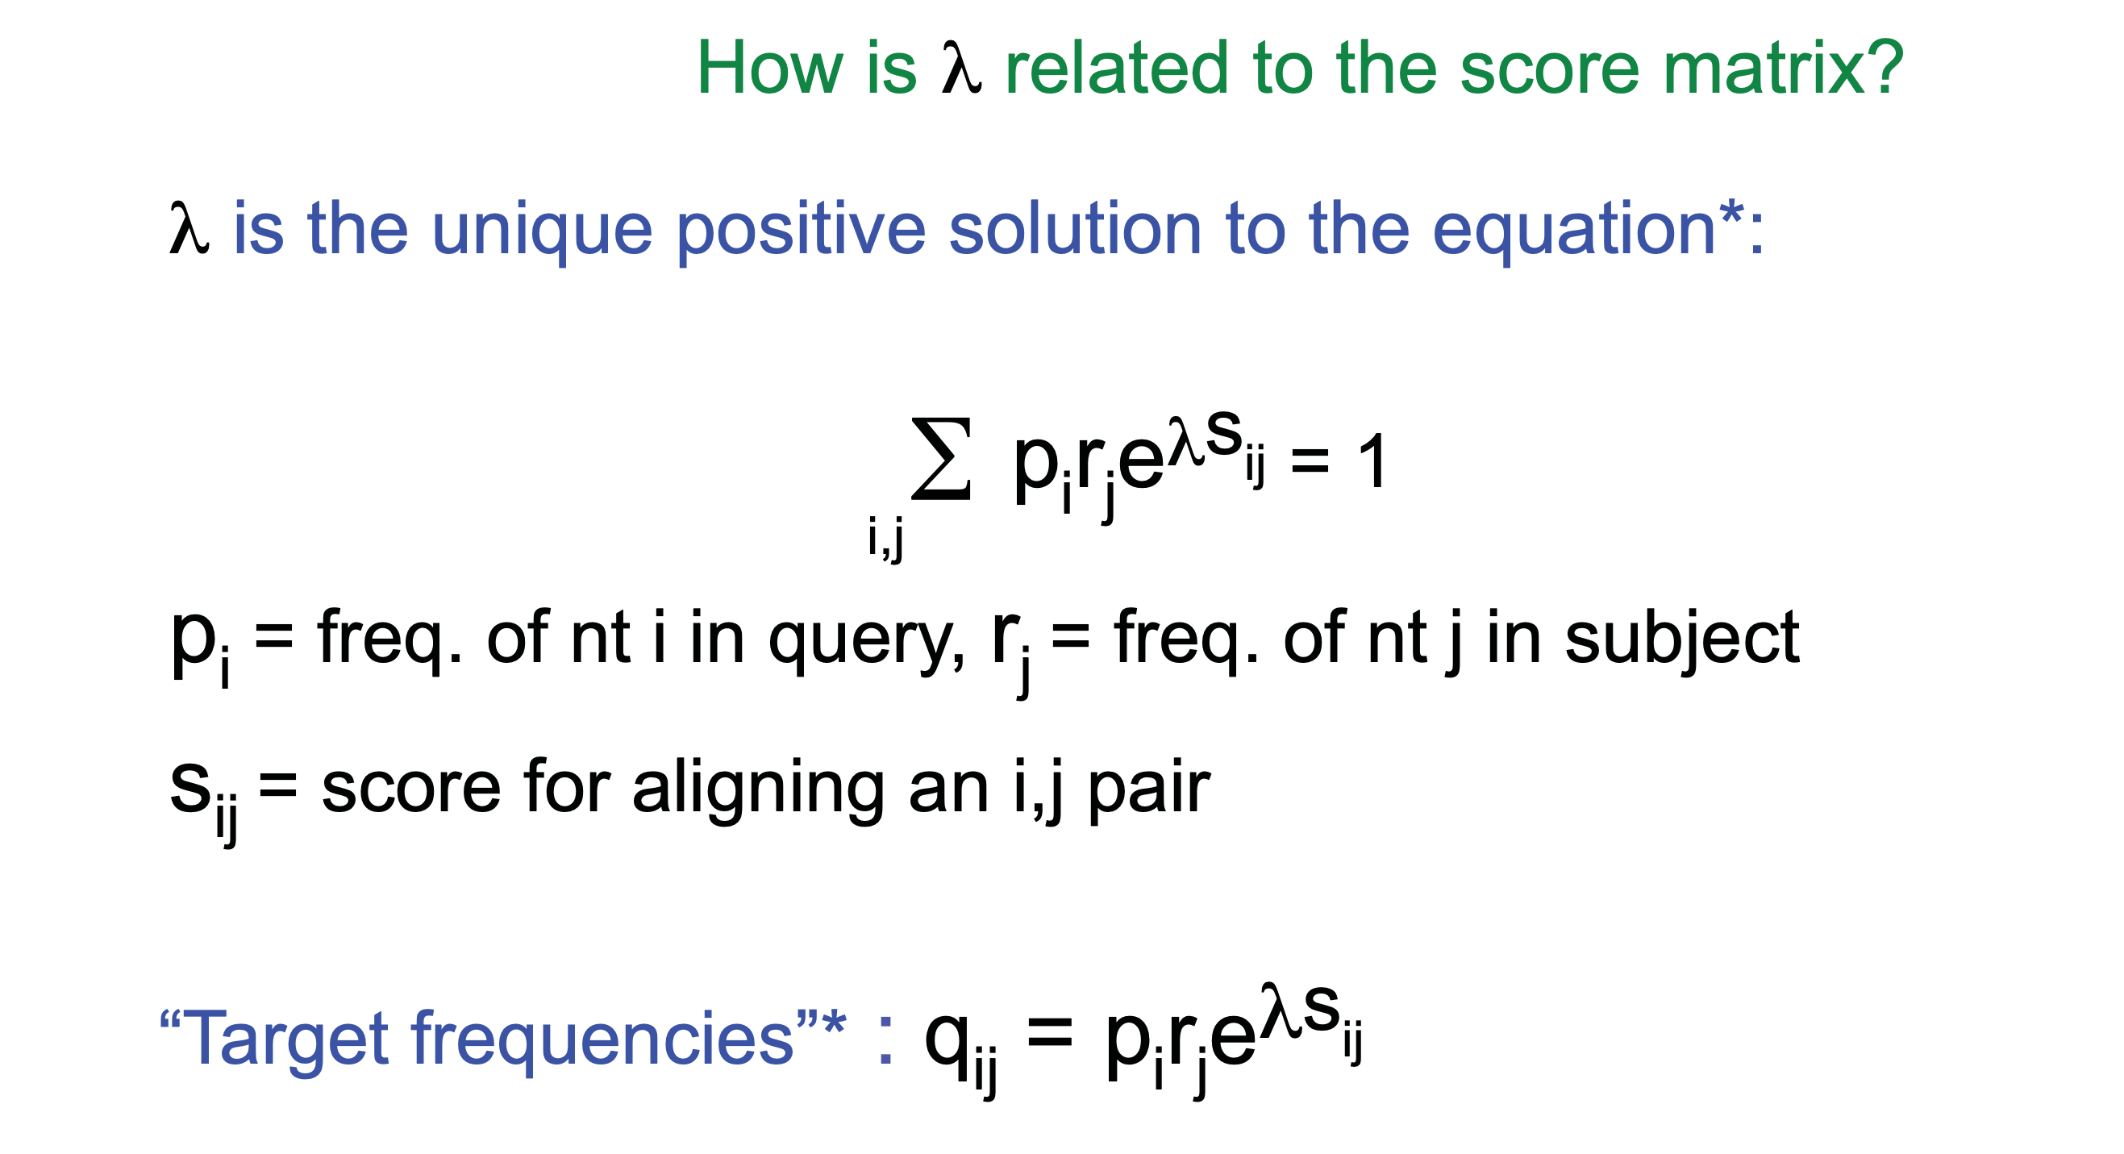
How is lambda related to the score matrix?

Slide 30
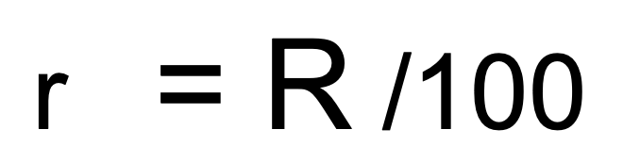
How does the % of identify affect your scoring matrix?
$$m=s_{ij}=ln(4(1-r)/3/ln(4r)$$

Slide 31
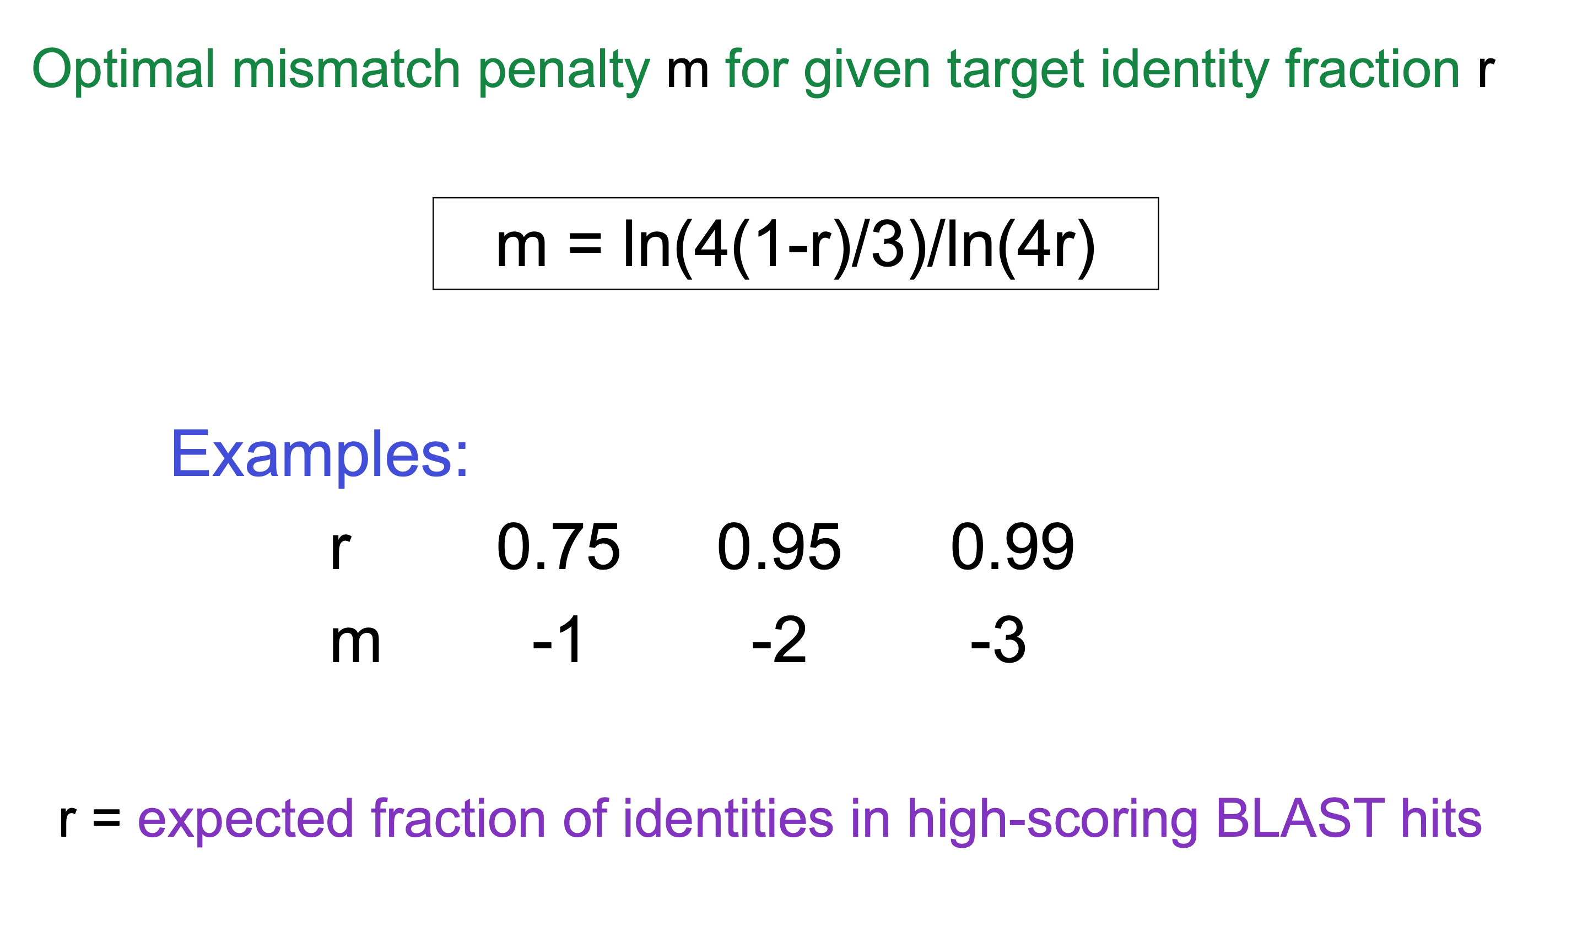
Assuming
$$m=ln(4(1-r)/3/ln(4r)$$
$$p_{i},p_{j}=\frac{1}{4}$$
Could you have a 66% identity match using this scoring value?

Slide 33
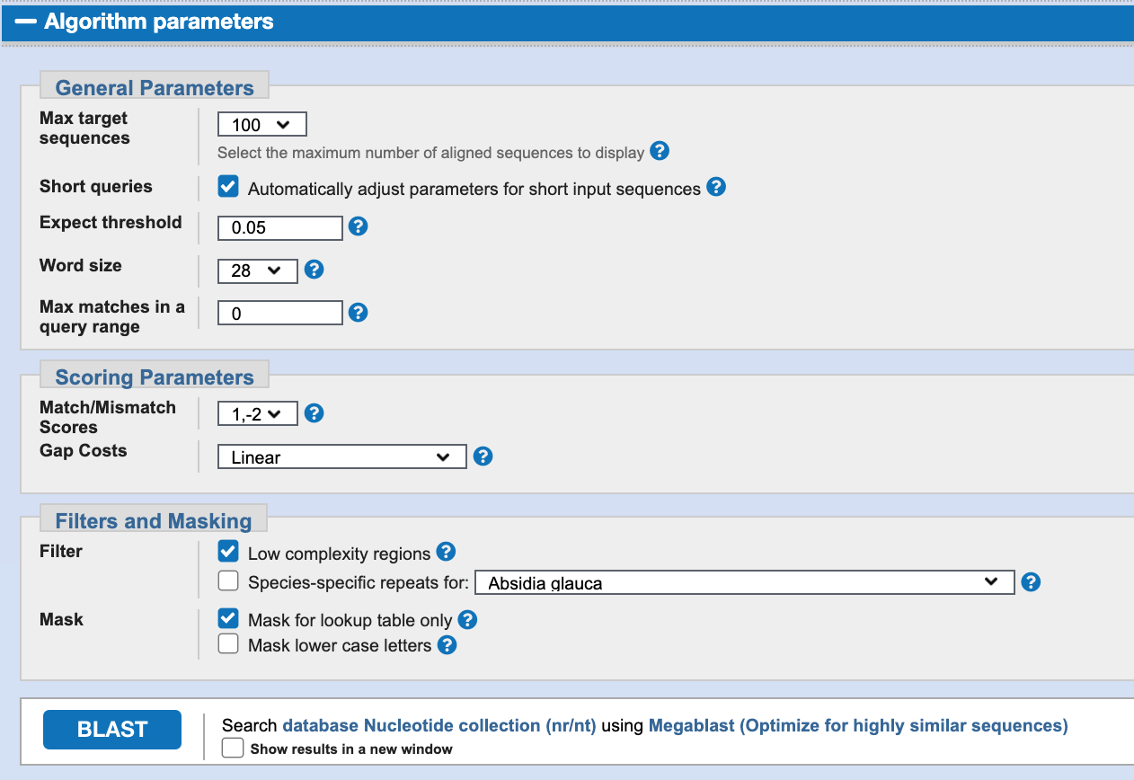

Slide 34
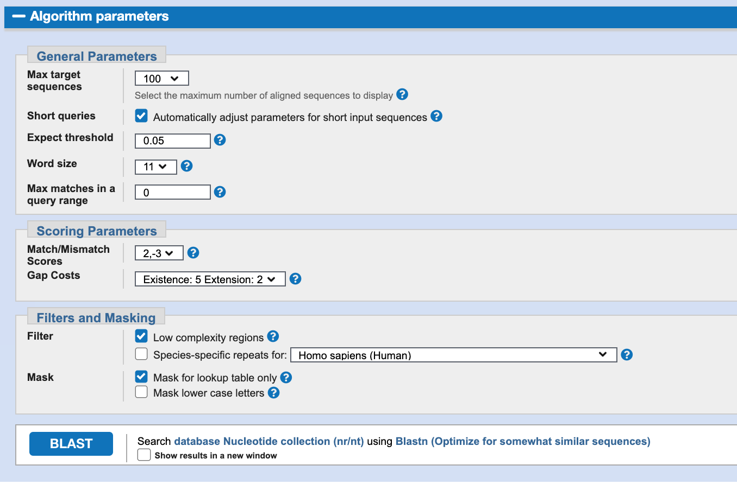

Slide 35
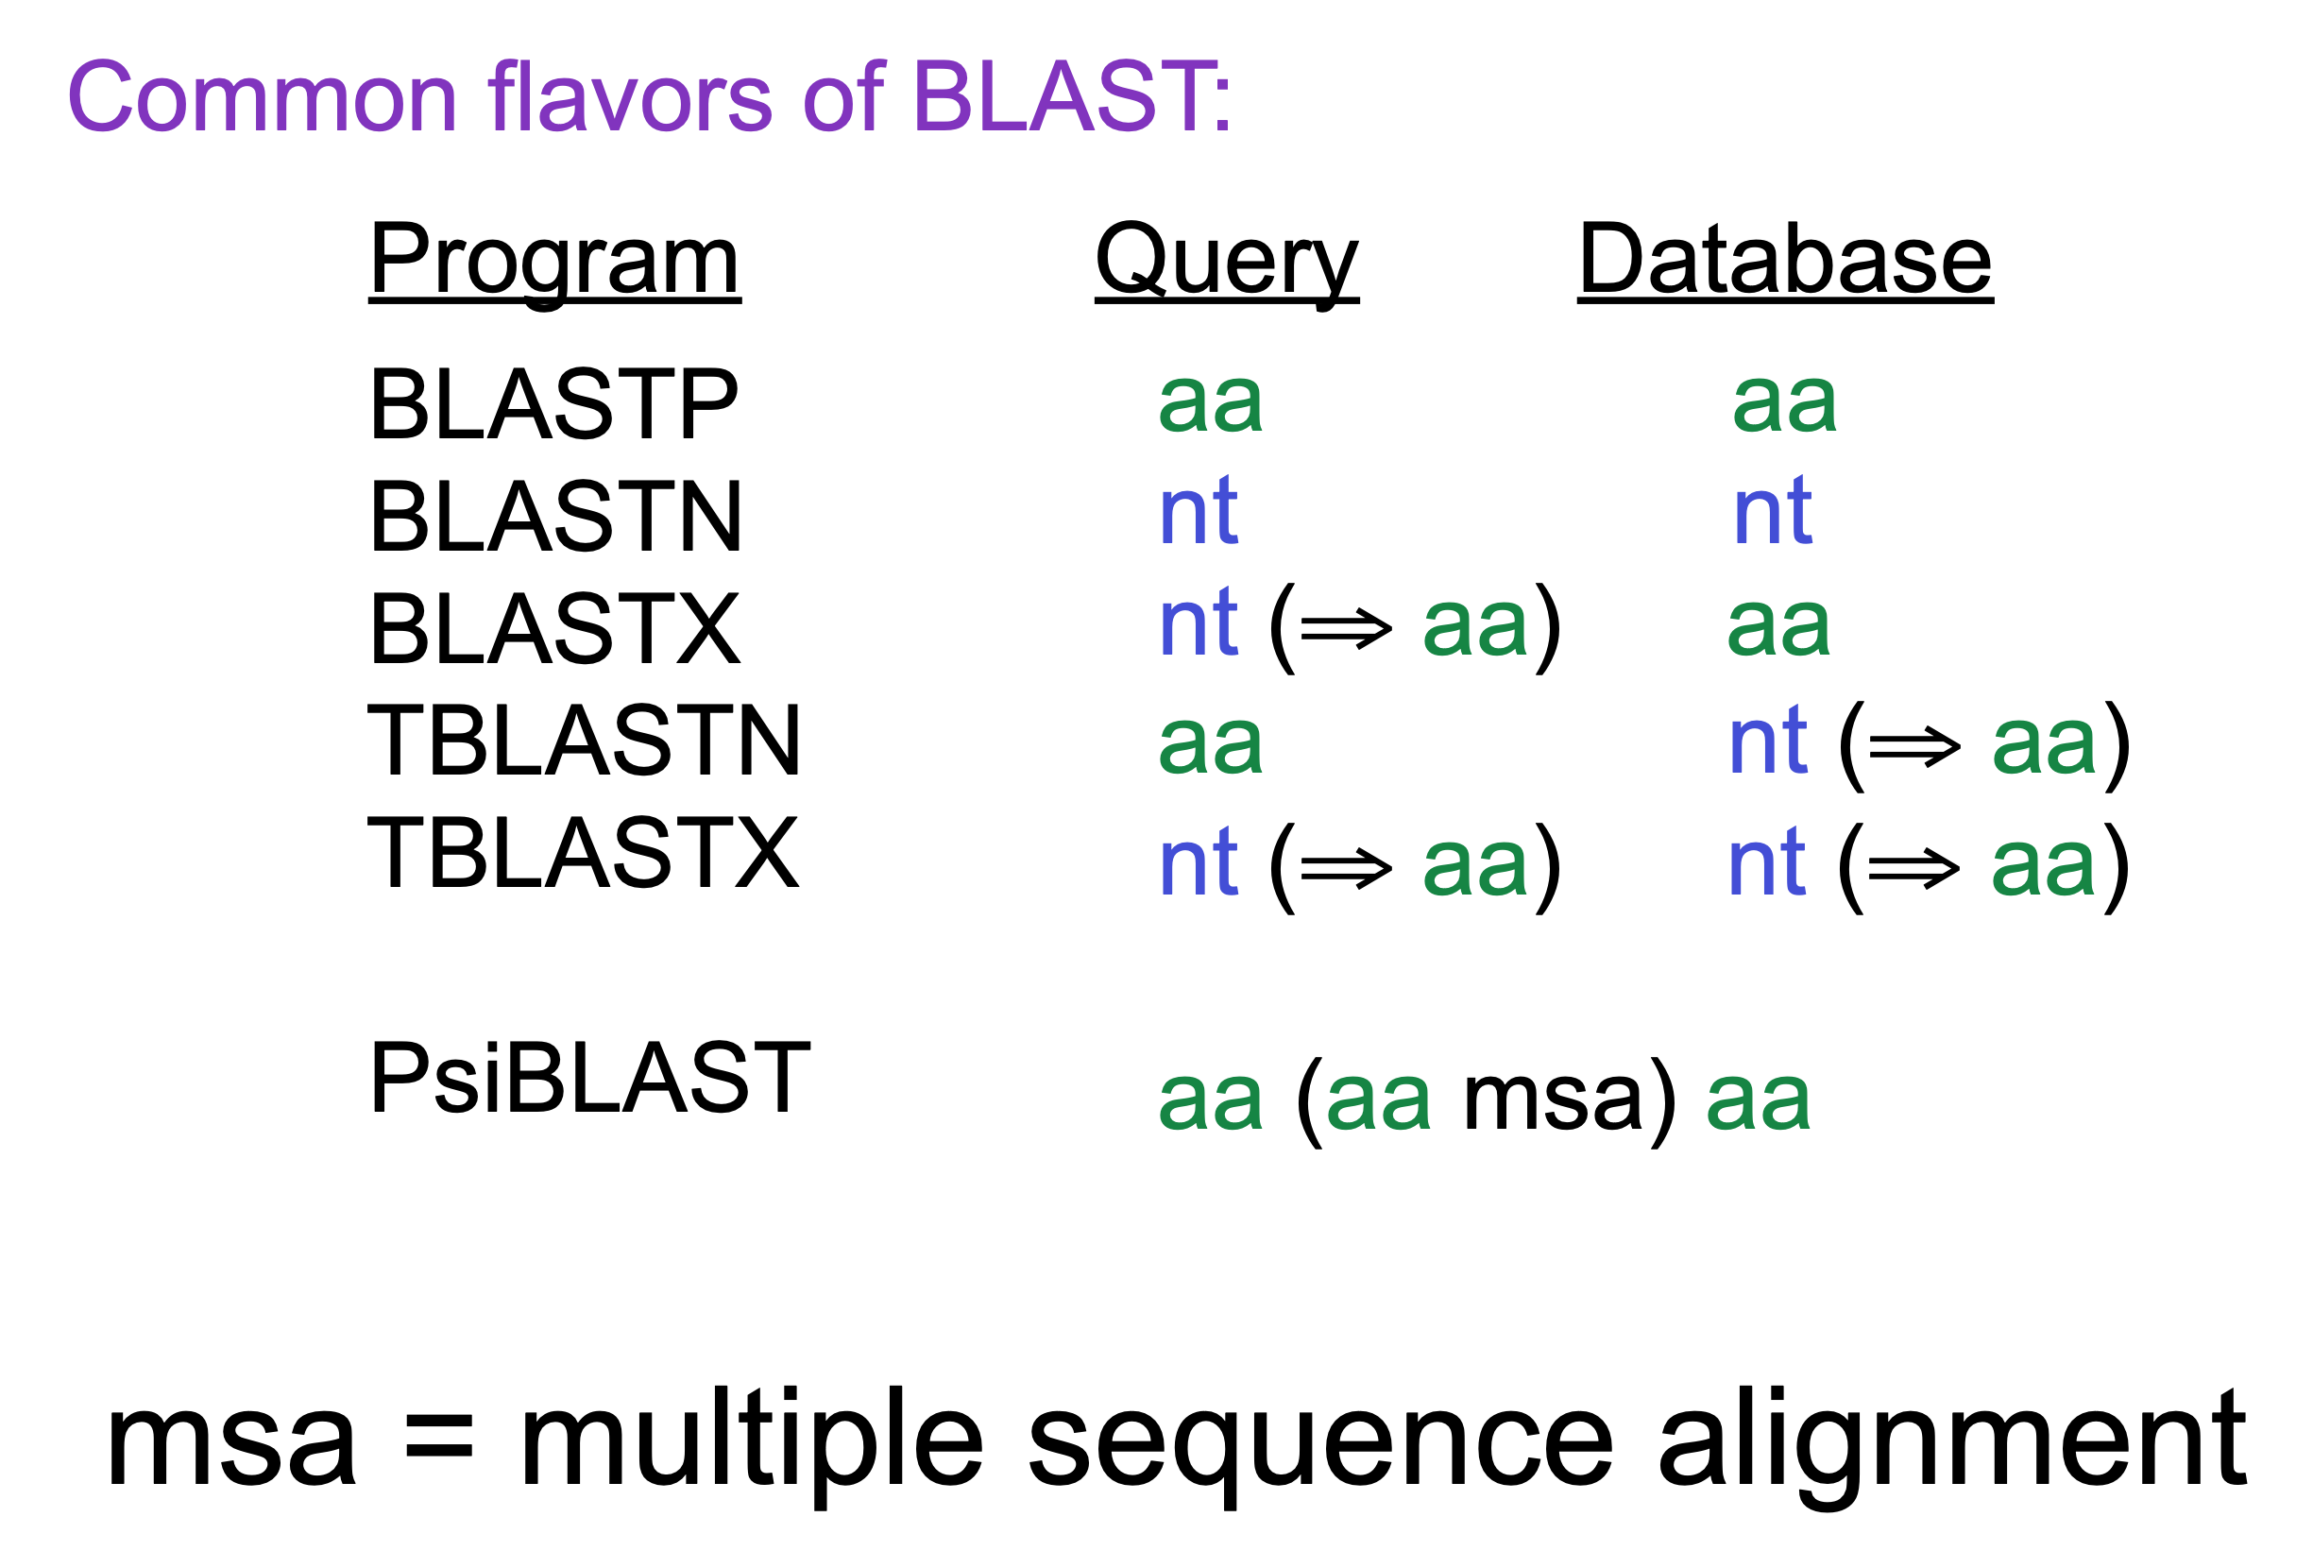

Slide 36
What is an E-value?
E-values were designed as the means of bringing some level of confidence to the search results, and are defined as the number of hits one can “expect” to see by chance when searching a database of a particular size. A smaller the e-value is “better”.
The e-value was intended to be used as a filtering and threshold parameter, where, supposedly by using them we could identify more “trustworthy” hits. Fundamentally the problem with e-values is that they depend on the database size and content, hence are not a measure of validity, reliability or correctness.
Excerpt From: “The Biostar Handbook: 2nd Edition.”

Slide 37
From Chapter 9: BLAST QuickStart
The alignments found by BLAST during a search are scored, as
previously described, and assigned a statistical value, called the “Expect Value.” The “Expect Value” is the number of times that an alignment as good or better than that found by BLAST would be expected to occur by chance, given the size of the database searched. An “Expect Value” threshold, set by the user, determines which alignments will be reported. A higher “Expect Value” threshold is less stringent and the BLAST default of “10” is designed to ensure that no biologically significant alignment is missed. However, “Expect Values” in the range of 0.001 to 0.0000001 are commonly used to restrict the alignments shown to those of high quality.
Excerpt From: “The Biostar Handbook: 2nd Edition.”

Slide 38
At the end…
Since both the alignment lengths and the alignment scores are ingredients to the E-value formula, ranking by E-values typically shows a strong correlation to a ranking by score and lengths. E-values end up as a single “convenient” number that empirically seems to work well.
Excerpt From: “The Biostar Handbook: 2nd Edition.”

Slide 39
What is RefSeq
The NCBI Reference Sequence (RefSeq) project provides sequence records and related information for numerous organisms and provides a baseline for medical, functional, and comparative studies. The RefSeq database is a non-redundant set of reference standards derived from all the data deposited in GenBank that includes chromosomes, complete genomic molecules (organelle genomes, viruses, plasmids), intermediate assembled genomic contigs, curated genomic regions, mRNAs, RNAs, and proteins.”
Excerpt From: “The Biostar Handbook: 2nd Edition.”

Slide 40
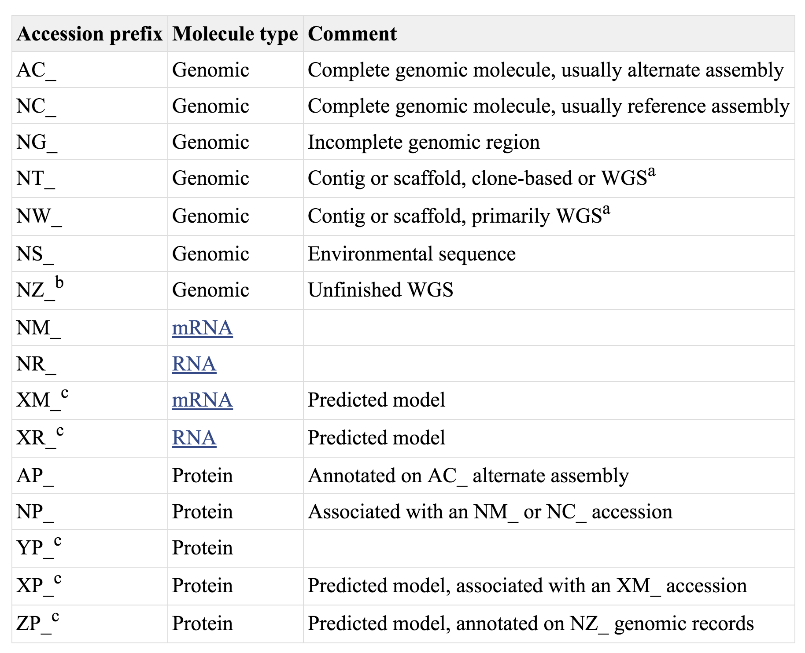
How are RefSeq sequences named?
Remember exercise Part B (lab): the exercise ask to remove XP and XM entries
If you see “_” then the sequence is part of RefSeq

Slide 41
Before you go…
What is the GENBANK format?
GenBank format is one of the oldest bioinformatics data formats, originally invented to bridge the gap between a human-readable representation and one that can be eﬀiciently processed by the computer. The format (defined here¹) has a so-called fixed-width format, where the first ten characters form a column that serves as an identifier and the rest of the lines are information corresponding to that identifier.

Slide 42
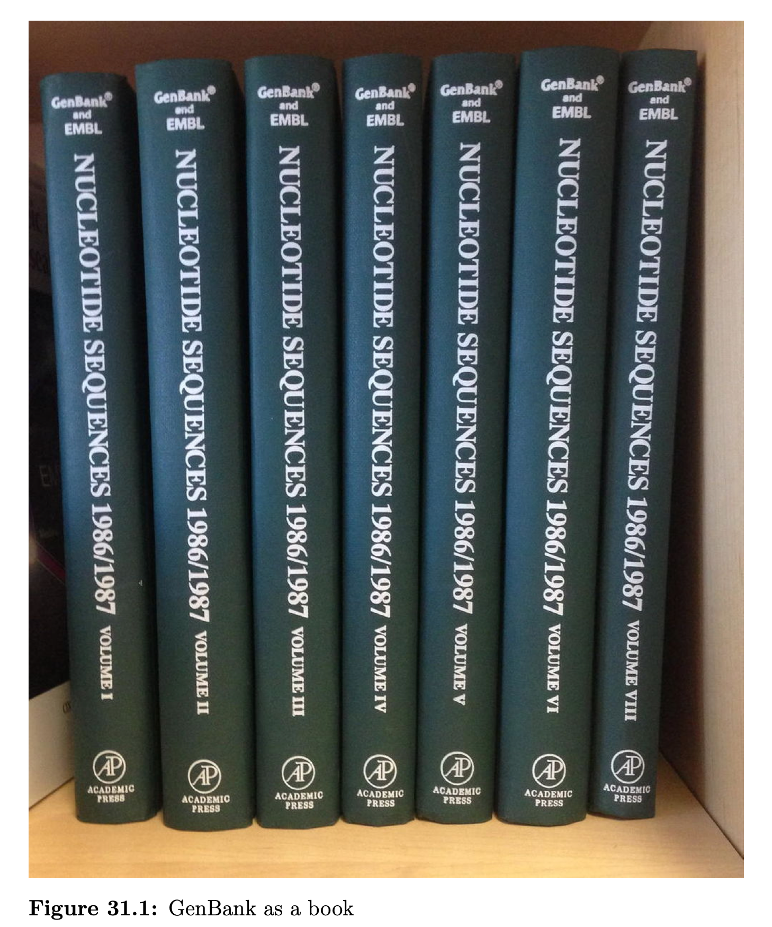
GenBank
The GenBank sequence database is an open access, annotated collection of all publicly available nucleotide sequences and their protein translations. It is produced and maintained by the National Center for Biotechnology Information (NCBI; a part of the National Institutes of Health in the United States) as part of the International Nucleotide Sequence Database Collaboration (INSDC).
The database started in 1982 by Walter Goad and Los Alamos National Laboratory. Release 242.0, produced in February 2021, contained over 12 trillion nucleotide bases in more than 2 billion sequences.[4] GenBank is built by direct submissions from individual laboratories, as well as from bulk submissions from large-scale sequencing centers.

Slide 43
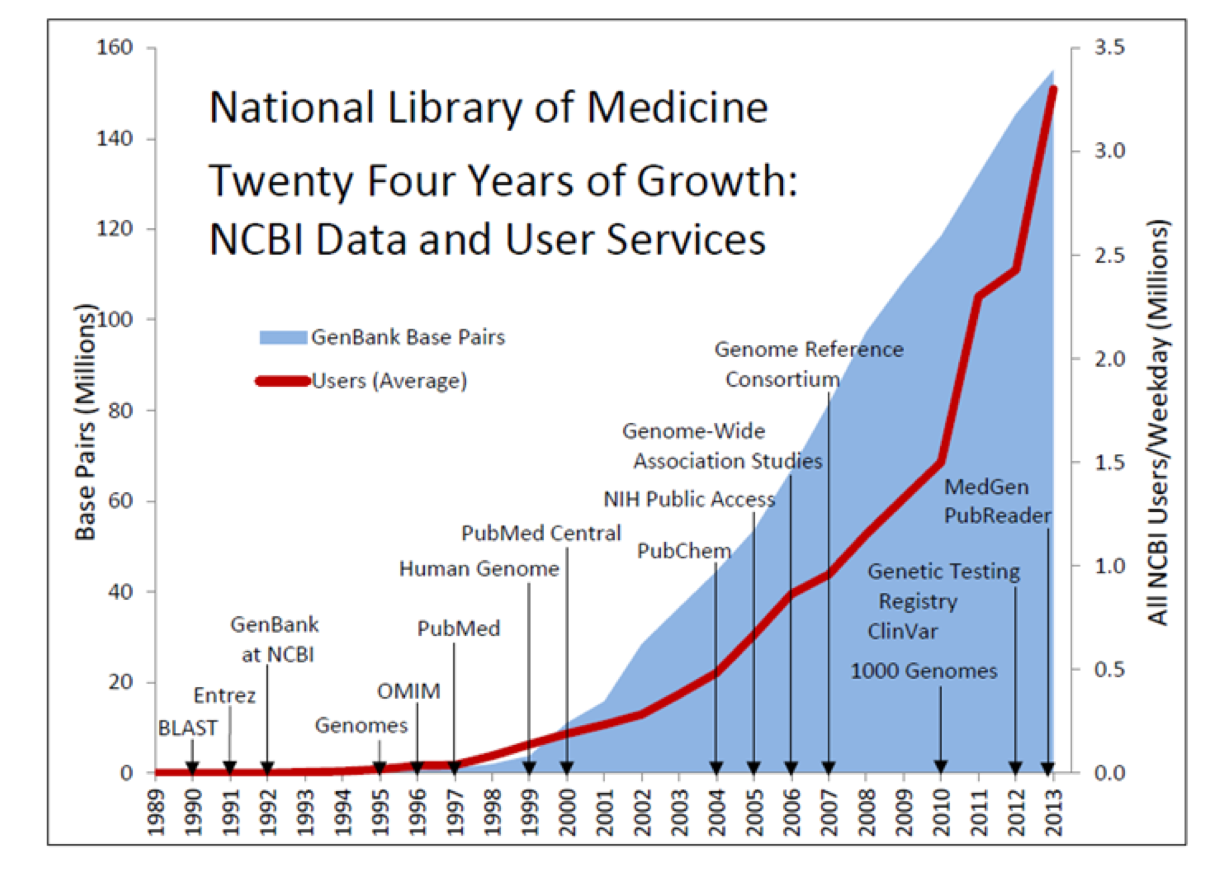
History
Walter Goad of the Theoretical Biology and Biophysics Group at Los Alamos National Laboratory and others established the Los Alamos Sequence Database in 1979, which culminated in 1982 with the creation of the public GenBank.[5] Funding was provided by the National Institutes of Health, the National Science Foundation, the Department of Energy, and the Department of Defense. LANL collaborated on GenBank with the firm Bolt, Beranek, and Newman, and by the end of 1983 more than 2,000 sequences were stored in it.
In the mid 1980s, the Intelligenetics bioinformatics company at Stanford University managed the GenBank project in collaboration with LANL.[6] As one of the earliest bioinformatics community projects on the Internet, the GenBank project started BIOSCI/Bionet news groups for promoting open access communications among bioscientists. During 1989 to 1992, the GenBank project transitioned to the newly created National Center for Biotechnology Information.[7]
from 1982 to the present, the number of bases in GenBank has doubled approximately every 18 months

Slide 44
K. Mullis invented
PCR
Insulin was the first protein to be sequenced by F. Sanger
Sequence of DNA, F. Sanger, “Sanger-method”
Watson, Crick, Wilkins and Franklin discover the structure of DNA
1945
1953
1968
1973
1977
Berg, Cohen, and Boyer create “recombinant DNA”

Slide 45
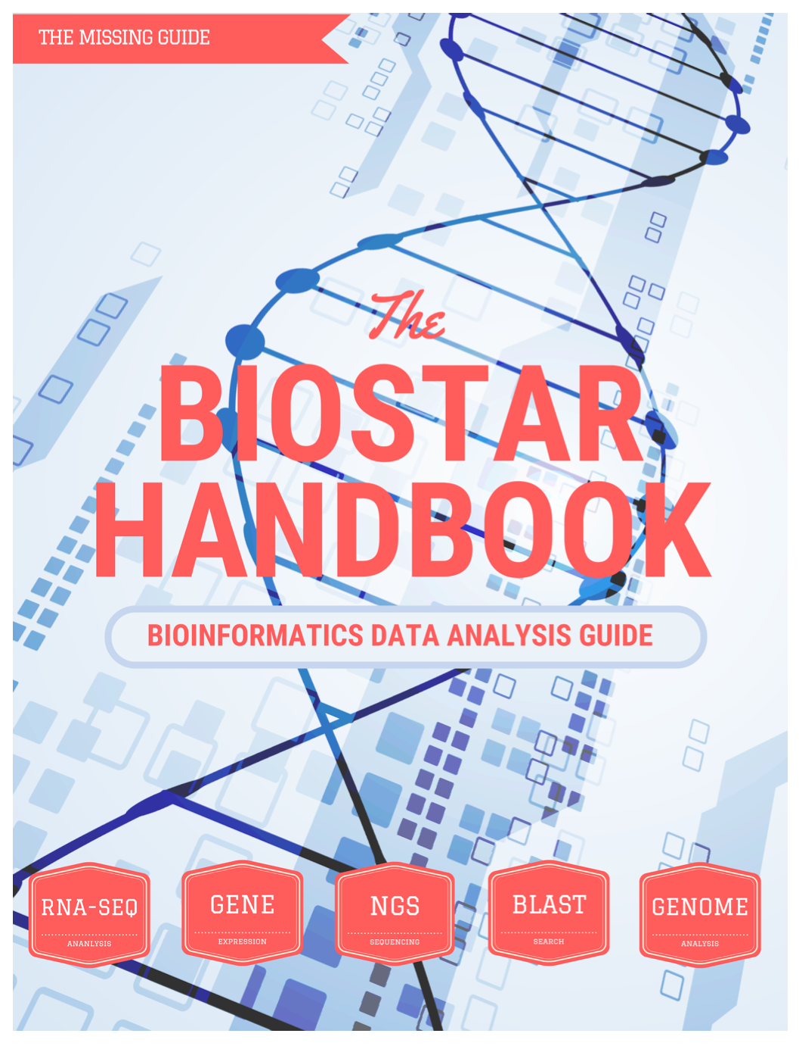
Another thing before you go…
Bioinformatician companion
History of Bioinformatics
History of Genetics
Molecular Biology
Crushing course in Genetics
Hidden Markov Models
Computational Biology Algorithms

